Slide 1
Agile Fundamentals
A Course from ThoughtWorks Studios
CONFIDENTIAL AND RESTRICTED.
These materials are for the sole use of the individuals to whom they were delivered, and any further copying or distribution is prohibited.
Notes:
Hello, and welcome to The Origins of Agile Software Development, a module in Agile Fundamentals. This module is brought to you by ThoughtWorks Studios, makers of Mingle, Go, and Twist.

Slide 2


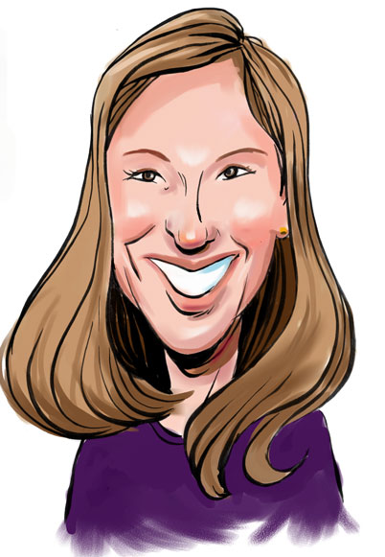
Your Facilitator
Your Facilitators
Name | David Kershaw
Role | Trainer
Email | dkershaw@thoughtworks.com
Phone | 415.525.6596
Name | Patti Mandarino
Role | Trainer
Email | patti@thoughtworks.com
Phone | 312.560.2505
www.thoughtworks-studios.com
Copyright 2010 ThoughtWorks

Slide 3
Introductions
Who are you?
What do you do?
Why are you here?
All in 30 seconds or less.
Notes:
TIMING:
Introductions: < 5 minutes
Group Juggle: 5 – 8 minutes
Follow introductions with Group Juggle…
http://wilderdom.com/games/descriptions/GroupJuggle.html
Group Juggle
Fun way to start working together.
Can be used to learn names and develop a sense of interconnectedness.
Stand in a circle, toss a ball to someone, using his/her name, and they in turn toss it to someone else, using the next person's name.
Keep it going, then more balls are introduced and it starts gets crazy.
How to Run a Group Juggle Session
Set up & instructions for 1st round of group juggling
Arrange participants in a circle, not too close, not too far from one another
Include yourself in the circle
Explain that you are going to throw a ball to someone - pick someone out & ask their name, then say
"Hi Freddy, my name is James...here you go!" [underarm throw a ball to Freddy]
Freddy then says "Thank you James", picks someone and says "Hi X, my name is Freddy...here you go!" [throw]....they say "Thank you, Freddy] and on we go.
If you're not trying to learn names, skip the naming part & just throw!
The challenge from here is simply to get the ball thrown around to everyone in the circle, and finally back to the trainer.
2nd round of group juggling
I then say, "Right, well done, now let's see if we can that again - making sure we use the same order, and using each other's names. Remember to say the name of the person you are throwing to, and thank the person, by name, for throwing it to you, OK?"
On the second round, most people will be challenged to remember who to throw it to, and the two names! Take it slow, help the group out, so that each person has a successful second round.
3rd round of group juggling
I then say, "Good, so how about we do it again, but this time, let's let's see how fast we can do it, OK? Here we go...Hi Freddy, my name is James...." [throw]
It will go pretty fast this time, and the group will probably feel quite pleased with themselves.
4th round of group juggling - introducing more balls
I then say, "That's great, but I think you can do faster than that. Come on, let's see how we can really go..." [I then throw and say the name with super fast enthusiasm to set the tone!]
After the first ball has passed through a few hands, I take a 2nd ball out of my pocket (surprise!), and casually, but earnestly say "Hi Freddy...." [throw].
By now everyone is so well trained, the 2nd ball will automatically keep going, and there will be a detectable sense of challenge/excitement.
After a bit, I introduce a 3rd and 4th ball, up to about 6 balls.
Usually I let 4 to 6 balls be juggled for a while (note the balls will be coming back again to the trainer - just keep them going). A group of 12 adults can usually handle 4 to 6 quite well.
If I'm feeling conservative, I just let the group have the success of doing this number of balls, and collect them in when that seems to have been achieved.
But usually, once the group seems competent at 4 to 6 balls I gradually then introduce an unmanageable number of balls into the juggle & maybe also weird objects (e.g., kids soft toys) which all gets crazy, fun, out of control, etc. and ends in a hilarious shambles.
Generally doesn't require debriefing.

Slide 4
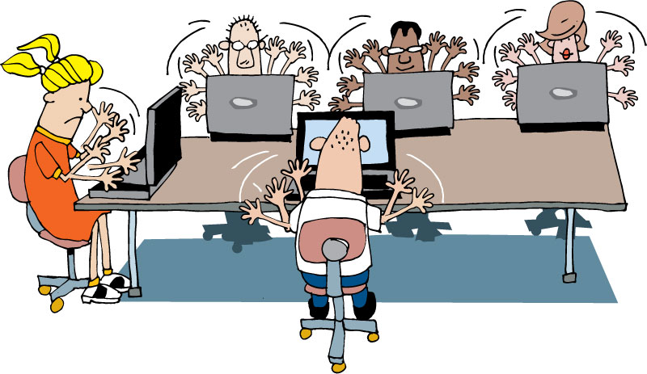
Housekeeping
Mobile phones
Laptops
Break times
Restrooms
Emergencies
Parking Lot

Slide 5
What’s coming up…
Origins of Agile
Agile Core Practices
Development Practices
Quality
Planning and Managing a Project
Notes:
TIMING: <= 2 minutes
Just a sentence or two about each topic

Slide 6
Expectation Setting
We will review a lot of concepts, practices and ideas for a shared knowledge of Agile vocabulary.
This is not a custom class for your organization.
We will try to address various scenarios for implementation of these practices, but some are too complex to get into.
Your next steps are to create an adoption plan outlining which practices will be adopted, when and how.

Slide 7


Why are we here?
Hopes
Concerns
Notes:
Capture hopes and concerns about both the course and the organization’s adoption of Agile.
TIMING: 3 – 5 minutes

Slide 8
Process Doodle
Divide into groups of 4 per group
Using materials, graphically represent your current development process.
Roles
Artifacts
Challenges
Do not use people’s names
No criticism
Have fun!
Notes:
http://blog.tastycupcakes.com/2009/06/process-doodle/
Process Doodle
By Michael McCullough, on June 20th, 2009
Timing: 20 mins
Ingredients:
Whiteboards and/or flip-charts
Markers
Directions:
Divide the participants in to groups and ask them to graphically represent their current development process. Have them think about roles, artifacts produced, and challenges. Invite them to be creative and to not worry about using any formal notation (UML, Gantt Charts, RUP, etc.). Ask them not to use people’s names, or to criticize personalities.
Each team will then then present their creation to the whole group.
Learning Points:
This is an interesting and fun way for a facilitator to gain visibility in to what is working and what the challenges are in an organization’s current process.
This exercise also creates more transparency within a team, by giving people a chance to see how others characterize the process.

Slide 9
Questions?
Origins of Agile
Notes:
Thank you for joining us for The Origins of Agile Software Development, a module in Agile Fundamentals. The next module in the series is The Origins of Agile, in which we’ll look at the evolution of agile methodologies.

